Slide 1

Black History Month
Lakessa Johnson
PLC Coach

Slide 2
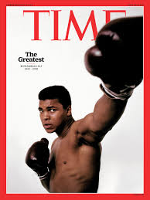

Muhammad Ali

Slide 3
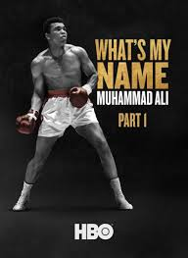
Who Was Muhammad Ali?
Muhammad Ali was a boxer, philanthropist and social activist who is universally regarded as one of the greatest athletes of the 20th century. Ali became an Olympic gold medalist in 1960 and the world heavyweight boxing champion in 1964.

Slide 4
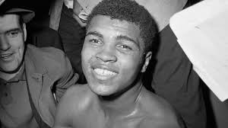
Early Life
Muhammad Ali was born on January 17, 1942, in Louisville, Kentucky. His birth name was Cassius Marcellus Clay Jr.
At an early age young Muhammad Ali showed that he wasn't afraid of anyone inside or outside of the ring. Growing up in the segregated South, he experienced racial prejudice and discrimination firsthand.
At the age of 12, Muhammad Ali discovered his talent for boxing through an odd twist of fate. After his bike was stolen, Ali told a police officer that he wanted to beat up the thief.

Slide 5
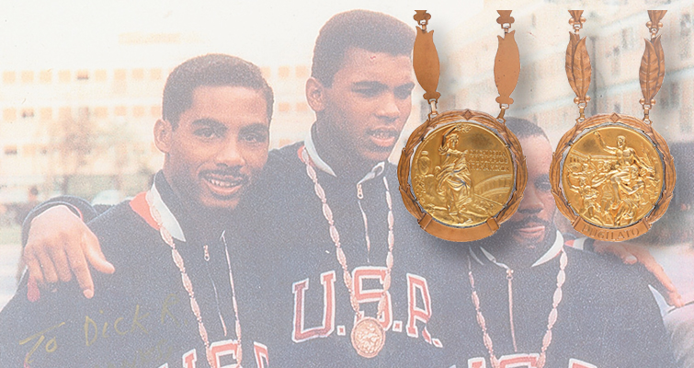
Olympic Gold
In 1960, Muhammad Ali won a spot on the U.S. Olympic boxing team and traveled to Rome, Italy, to compete. At six feet, three inches tall, Muhammad Ali was an imposing figure in the ring, but he also became known for his lightning speed and fancy footwork.

Slide 6
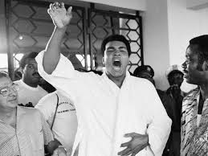
Philanthropy
In his retirement, Ali devoted much of his time to philanthropy. Over the years Ali supported the Special Olympics and the Make-A-Wish Foundation, among other organizations. In 1996, he lit the Olympic cauldron at the Summer Olympic Games in Atlanta. It was an emotional moment in sports history.

Slide 7
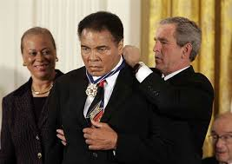
Awards
In 2005, Muhammad Ali received the Presidential Medal of Freedom from President George W. Bush.
Soon after Obama’s 2009 inauguration, Muhammad Ali received the President's Award from the NAACP for his public service efforts.

Slide 8
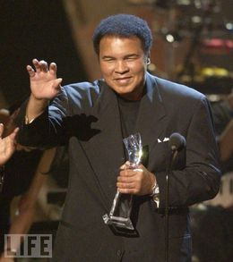
Muhammad Ali died on June 3, 2016, in Phoenix, Arizona after being hospitalized for what was reportedly a respiratory issue. He was 74 years old.
The boxing legend had been suffering from Parkinson’s disease and spinal stenosis.

Slide 9
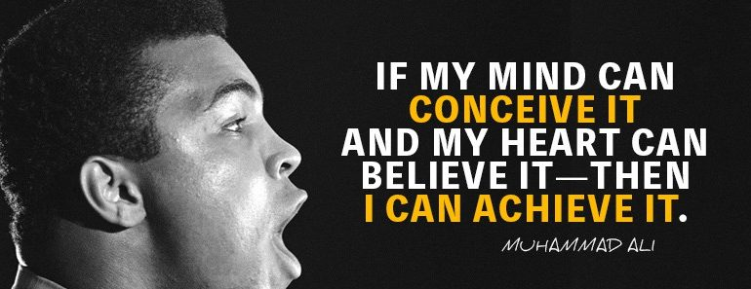
Muhammad Ali

